Slide 1
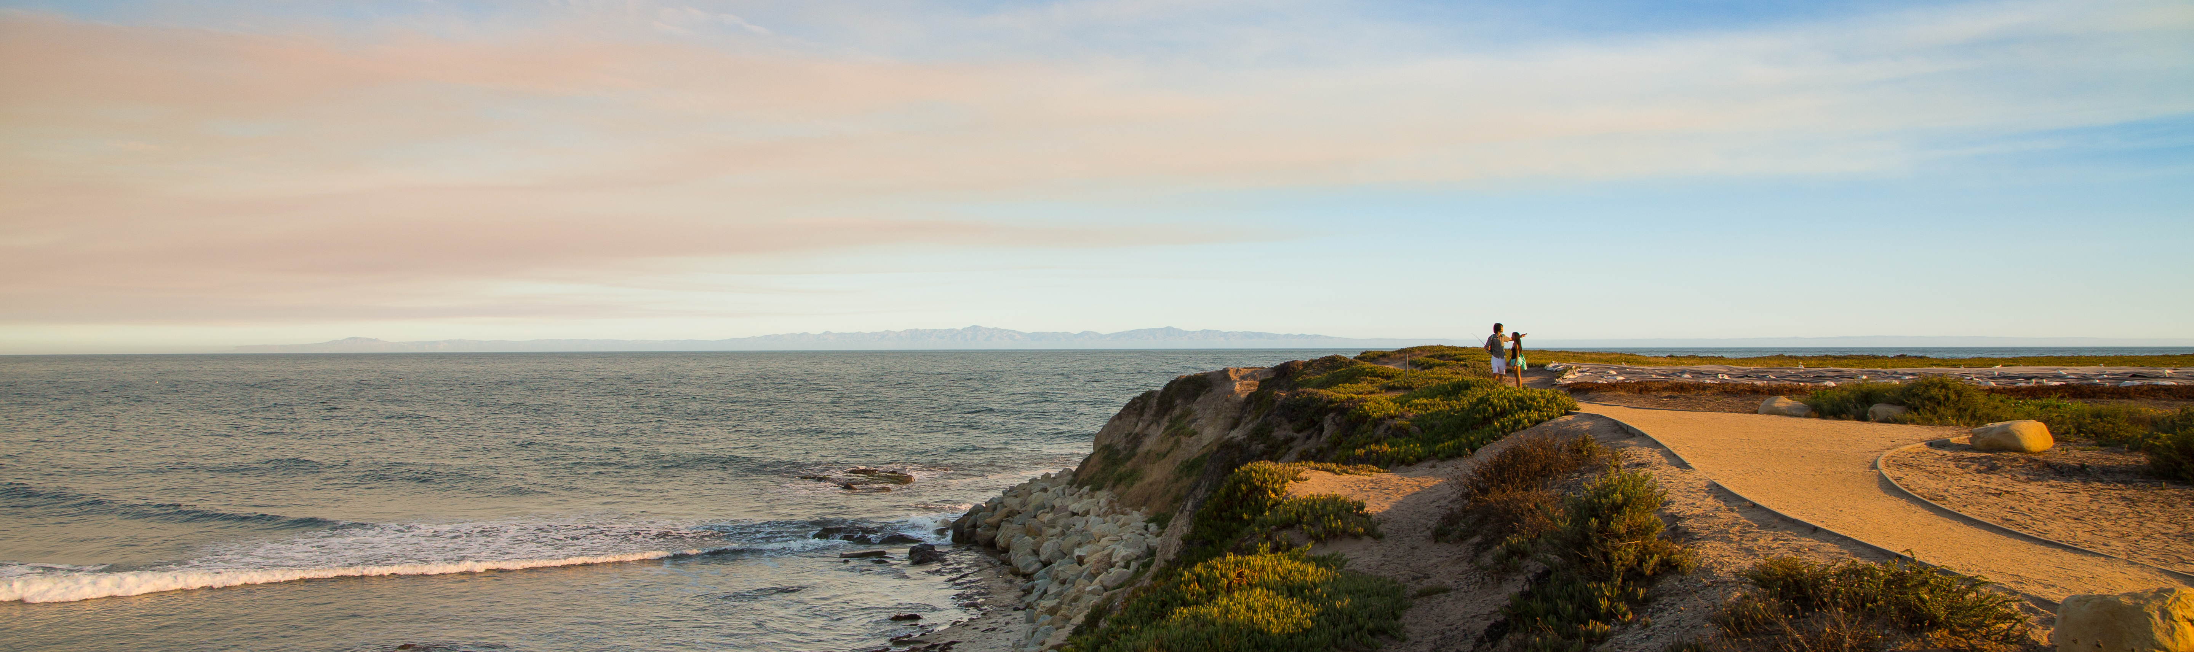




Reproducing and Replicating Spatial Data Science
Joseph Holler, Peter Kedron, and Sarah Bardin
HEGSRR.github.io
Funding Support from NSF BCS-2049837, NSF OAC-1743184

Slide 2
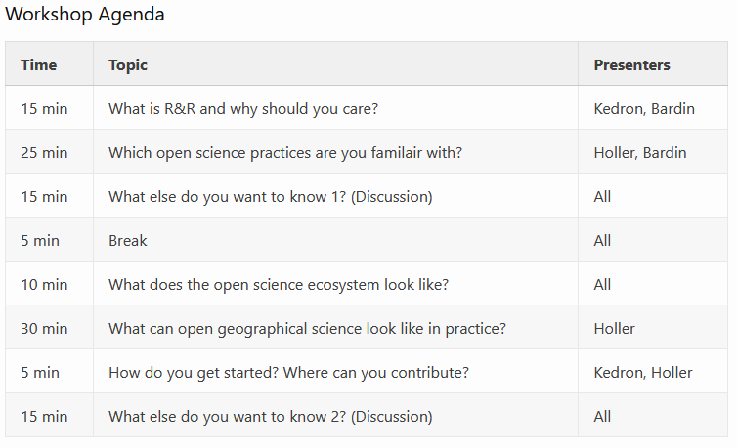
Reproduction and Replication
Framing expectations
Central Objective:
Situate R&R in the geography and spatial data science
&
introduce selected research practices and resources you can use to make your work more reproducible

Slide 3
Tell us what you think
Please take 2mins to complete a short survey about open science research practices
Protocol
Sort 11 open and reproducible research practices (ORRP)
Already using
Aware and interested in using
Unaware or uninterested
10 likert technology adoption questions
Share deidentified data
Follow-up surveys (immediate, one year)

Slide 4
Defining Reproducibility and Replicability
A brief definition for spatial data science

Slide 5
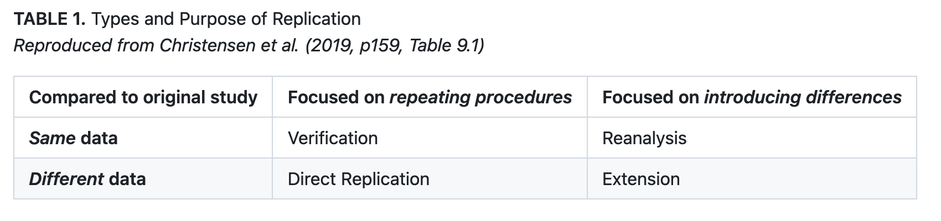
Reproduction and Replication
(Schmidt 2009, Gomez et al. 2010, Barba 2017, Christensen et al. 2019, NASEM 2019)

Slide 6
Reproduction and Replication
(Schmidt 2009, Gomez et al. 2010, Barba 2017, Christensen et al. 2019, NASEM 2019)
Reproduction
Same data, same procedure, same results, same context

Slide 7
Reproduction and Replication
(Schmidt 2009, Gomez et al. 2010, Barba 2017, Christensen et al. 2019, NASEM 2019)
Reproduction
Same data, same procedure, same results, same context
Replication
New data, similar procedure, similar results, same or new context

Slide 8
Veridical Spatial Data Science
Munafo et al. (2016), Kedron et al. (2020), Yu & Kumbier (2020)
Principled inquiry to extract reliable and reproducible information from spatialtemporal data, with an enriched technical language to communicate and evaluate empirical evidence in the context of human decisions, domain knowledge, and geographic confounds; supported by a system of external validation and evidence accumulation based on the purposeful replication of findings across space and time.
(Adapted from Kedron and Bardin 2021, Yu and Kumbier 2020)

Slide 9

Missing Replication Studies
BCS-2049837
Geographers are thinking about R&R, but not attempting replications
Reproducibility
Replicability
81% Consider reproducibility of their own work
71% Discuss reproducibility with colleagues
53% Consider reproducibility during peer-review
74% Consider replicability of their own work
65% Discuss replicability with colleagues
59% Consider replicability during peer-review
14%
31%
Reported attempting a reproduction
(7% attempt publishing)
Reported attempting a replication
(21% attempt publishing)

Slide 10
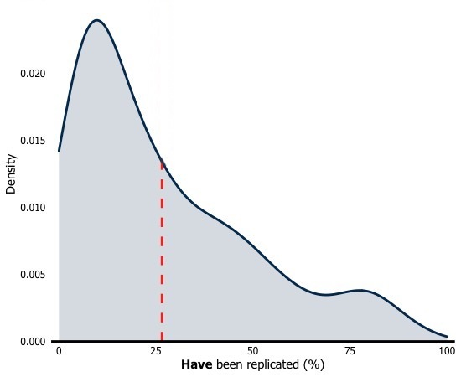
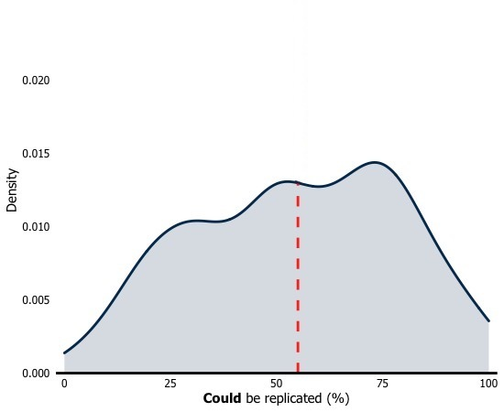
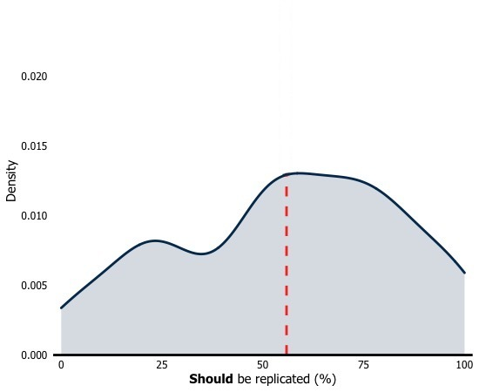
Missing Replication Studies
BCS-2049837
What percentage of geographic research do you believe …
Density
0.020
0.015
0.010
0.005
Has been replicated
Could be replicated
Should be replicated

Slide 11
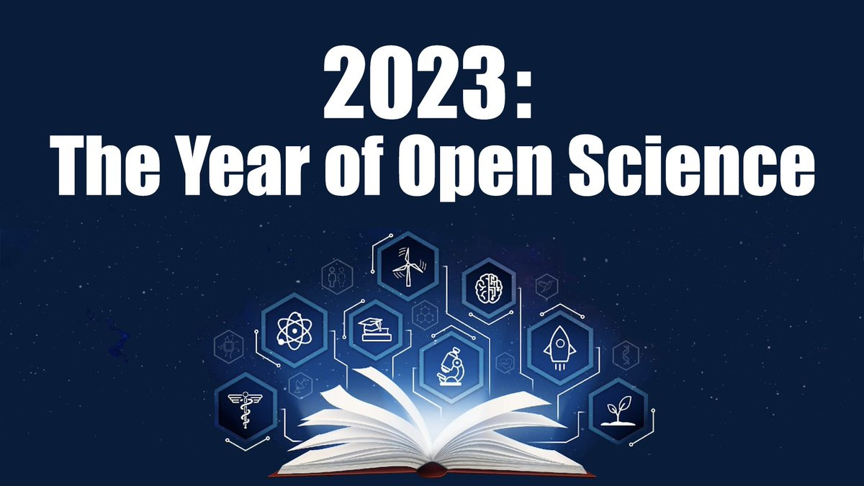
Notes:
2023 is the Year of Open Science
At least as declared by the White House Office of Science and Technology Policy (OSTP), which follows a
broader trend in the research community to move toward open science practices and
Passage of the Foundations of Evidence Policymaking Act (PL 115-435) put into law the need to link policy interventions to rigorous and transparent science
As just a few examples,
Agencies are updating public access plans to federal research
The NIH has instituted new data management and sharing standards
NASA is developing open science training materials
NSF has announced several DOC and funding calls to support open science and R&RI
This means there both in research where journals are introducing data and code sharing requirements, and in policy will be R&R standards and you will need to meet them to get funding

Slide 12
Practicality of R&R in the Policy Environment
Reproducible workflows are the pragmatic solution to large-scale research studies
Provides quality assurance that the numbers published in reports are accurate and error-free
Improves the efficiency of conducting large-scale program and policy evaluation
Enhances transparency of research allowing for scrutinizing of assumptions, data sources, and methods
Notes:
Peter has nicely laid out the high-minded case for R&R as means for aligning practices within the discipline of geography with the scientific method and need to be compliant to federal standards and journal publications required for disseminating findings from your research—basically if you want to contribute to the field, you’ll need to align to these principles.
but as a policy researcher I more often focus on the pragmatic and more practical considerations for using reproducible workflows in my research which has less to do with the long-term benefits and is more immediately focused on what is needed
Providing quality assurance (that is, ensuring that the numbers that are published in federal reports and used to inform congressional decision-making are accurate and error-free)
Improving the efficiency of conducting large-scale program and policy evaluation (that is, we frequently conduct the same or very similar analyses at repeated intervals. Having clear documentation of how a given research study was conducted from design through implementation makes it quicker and cheaper—in theory—to do the study again.
Making our processes transparent (work funded by the federal government is work done on behalf of and for the benefit of residents of the US at the expense of tax-payers. We have a responsibility from a good governance perspective to ensure that the research conducted is rooted in correct research principles that can stand up to the scrutiny of experts. R&R helps to facilitate close examination and review)
For these reasons, many federal agencies require the delivery of data files, code, and documentation to facilitate the full reproduction of a study (show language from RFP). Even when not explicitly required by the contract, it is expected from a professional courtesy standpoint to be able to produce these materials at any time upon request by the federal government.

Slide 13
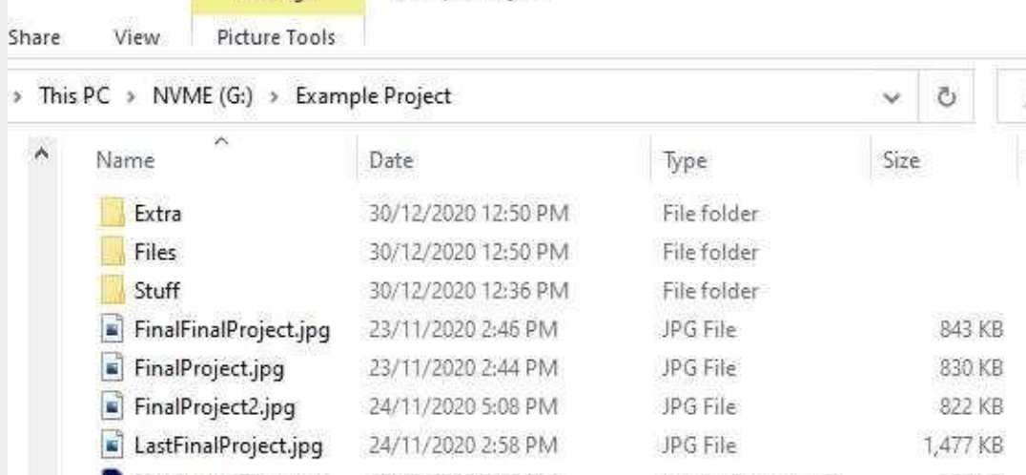
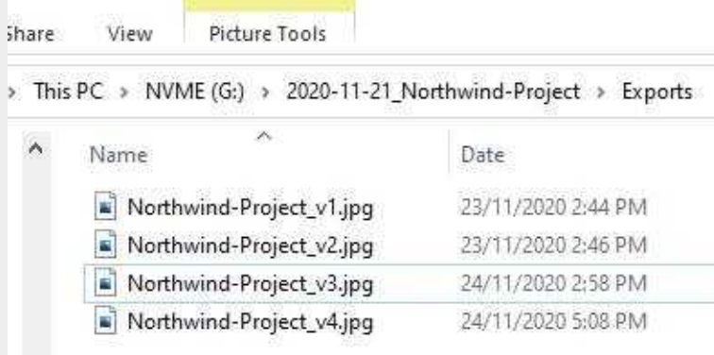

R&R as a Matter of Practice
It is all a spectrum
Less reproducible More reproducible
Notes:
As a matter of practice, reproducible work flows in applied research conducted in an environment such as the one that I work in comes in many different flavors.
And I’ll add that frequently better processes get implemented as a result of need/catastrophe as opposed to fantastic foresight and pre-planning. (R&R is a journey)
I like to think of R&R as continuum/gradient with low-hanging fruit through the most robust practices. While in theory it would be ideal if we were always implementing the absolute best practices at every stage of our research, in reality we tend to use practices to meet the challenge/need/requirements for the particular problem at hand. (high stakes research—where peoples’ lives and livelihoods are on the line requires the highest levels of R&R)
For instance, while using version control software such as git is really great for ABC, having well-organized and labeled project folders and file naming conventions can often get the job done for smaller, one off projects and that is better than the alternative practice of poorly documented/named files.
Nevertheless, embedding these principles into your research practices will always be better than the alternative regardless of where you end up professionally.

Slide 14

Our R&R Related Resources
Munafo et al. (2016), Kedron et al. (2020), Yu & Kumbier (2020)
hegsrr.github.io
5 Peer-reviewed Publications
8 Reproduction and Replication Studies
2 Surveys of Researcher Practices
Reproducible Project Repository Template
Manual In Development
2 Course Syllabi
9 RAs Mentored
~50 Students Engaged in R&R Studies
hegsrr.github.io/Workshop-SDSS-2023/

Slide 15
Open and Reproducible Research Practices
A quick review of practices in light of the survey results

Slide 16
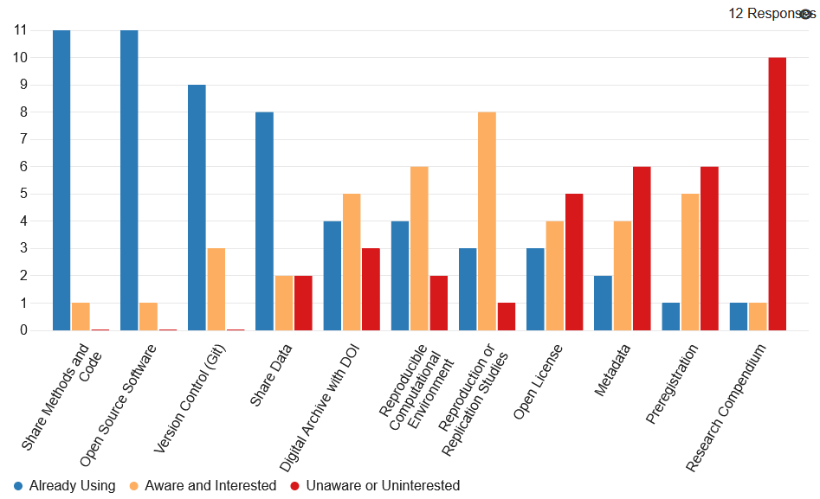
Survey Results: You
Goal: incremental progress as individuals and scientific community Be kind to your future self!

Slide 17
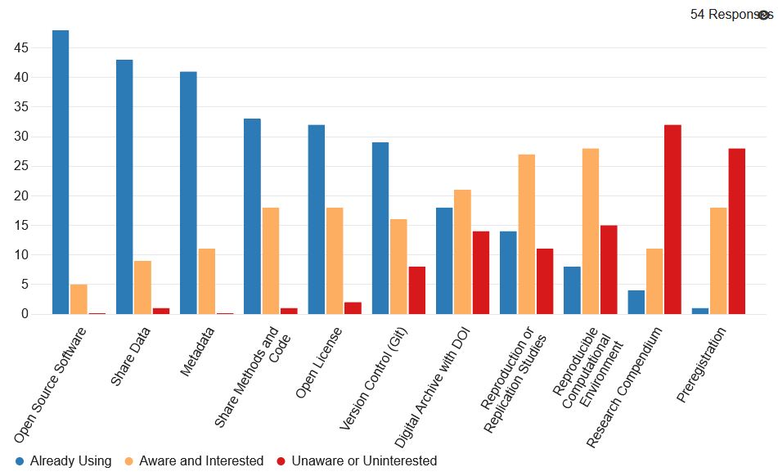
Results: Spatial Data Science Symposium
Goal: incremental progress as individuals and scientific community Be kind to your future self!

Slide 18
Share Methods and Code
Rmarkdown, Jupyter Notebook, Scripts, Models, Protocols
Do you share a complete description of your methods?

Slide 19
Open Source Software
Python, R, PostGIS, GeoDA, QGIS
Do you use and cite research software with (re)distributable source code?

Slide 20
Version Control
Git, GitHub, GitLabs, OSF projects
Do you manage and track changes to your study design, data, and code?
Best at tracking one line of plain text
GitHub integrates with Overleaf, OSF, Webpages

Slide 21
Share Data
Do you make the data for your study readily available in the most complete and unmodified form permissible by law and ethical protocols?

Slide 22
Digital Archive with DOI
DOI: Digital Object Identifier
Are all the components of your study digitally archived for long-term preservation, and labelled and linked with a persistent digital object identifier?

Slide 23
Reproducible Computational Environment
Docker container, public cyberinfrastructure, environment metadata
Do you provide access to your computational environment or sufficient information about your environment such that others can recreate it?

Slide 24
Reproduction and Replication Studies
Do you attempt and share
reproduction or replication studies?

Slide 25
Open Licensing
Creative commons, BSD-3, GPU, MIT…
Do you license your research products to allow others to use, modify, and redistribute them?

Slide 26
Metadata
Dublin Core, ISO 191**, Federal Geographic Data Committee (FGDC)
Do you provide information about your study and each of its components in a standardized format?

Slide 27
Preregistration
OSF, AsPredicted, Registered Reports
Do you publicly register your hypotheses and research design before conducting your work?

Slide 28
Research Compendium
HEGSRR Template, TIER Protocol, WORCS, o2r
Do you collect all components of your study together in a directory organized with consistent structure and relative links?

Slide 29
Open Science Ecosystem
Multiple points of entry and integration
Metadata Standards
Rmarkdown or Jupyter Notebooks
OSF: Open Science Foundation
Open Source Geospatial Software
GitHub
Where are you in your own research project and training?
Open Data and APIs
Overleaf LaTeX
Pedagogy Learning Teaching

Slide 30
Open Science Ecosystem
Multiple points of entry and integration
Metadata Standards
Rmarkdown or Jupyter Notebooks
OSF: Open Science Foundation
Open Source Geospatial Software
GitHub
In one undergraduate course…
Open Data and APIs
Overleaf LaTeX
Pedagogy Learning Teaching

Slide 31








Conducting Replications of Geographic Research
Dissect
Plan
Register
Attempt
Compare
Share
Pre-Analysis Template
Registration Guide
Repository Templates
Version Control
Issue Forum
Pedagogical Outline, PAP templates, and Repository Structures are all available Reproducible, Replicable, and Open Science Practices in the Geographical Sciences site (https://osf.io/c5a2r/) and HEGSRR Github Organization (https://github.com/HEGSRR)
Kedron
Expanding the Impact of Geographic Research
Pedagogical Approach and Infrastructure
Notes:
Dissect study and introduce open science practices and environments
Based on the collaborative dissection, we build a single project workflow written up as a PAP using a template we have created
That plan is registered before work begins
We then go about implementing the plan and attempting the replication. This involves gathering all the data, code, etc. On every attempt we have run into issues because something was not available of a research decision was not clear. This is an opportunity to critically evaluate those decisions using a spatial perspective. We try to reconstruct the researcher decision and try different specifications to test sensitivity and corresponding claims.
Whenever changes are made, those are recorded in the PAP and the registration is updated.
We compare results, and again back track if we find something we missed and need to adjust
Share everything via OSF, which allows us to link the data and procedural info in Github and the PAP in one project

Slide 32
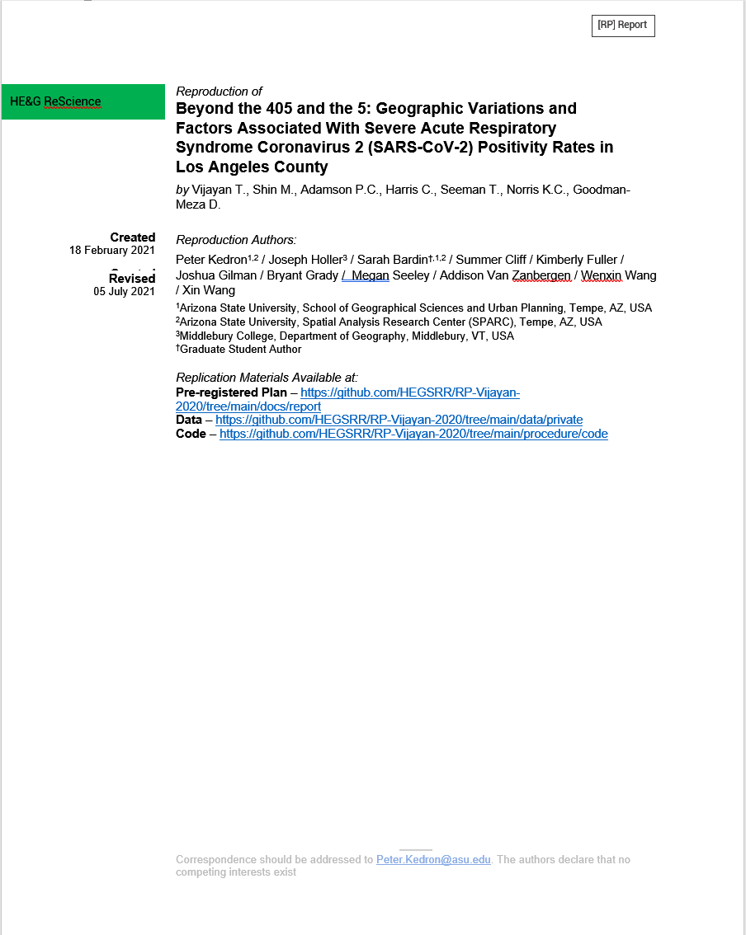
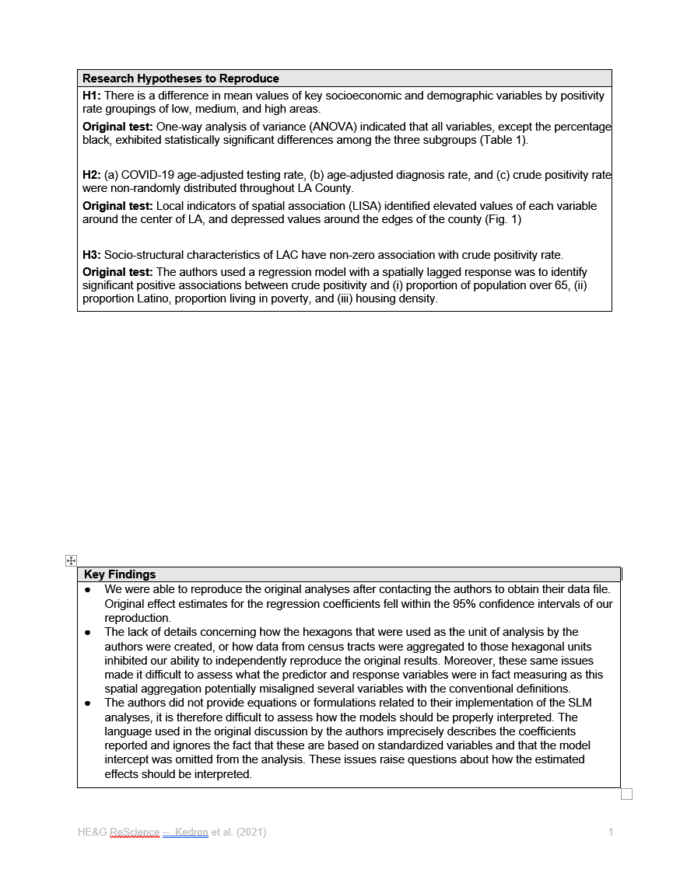
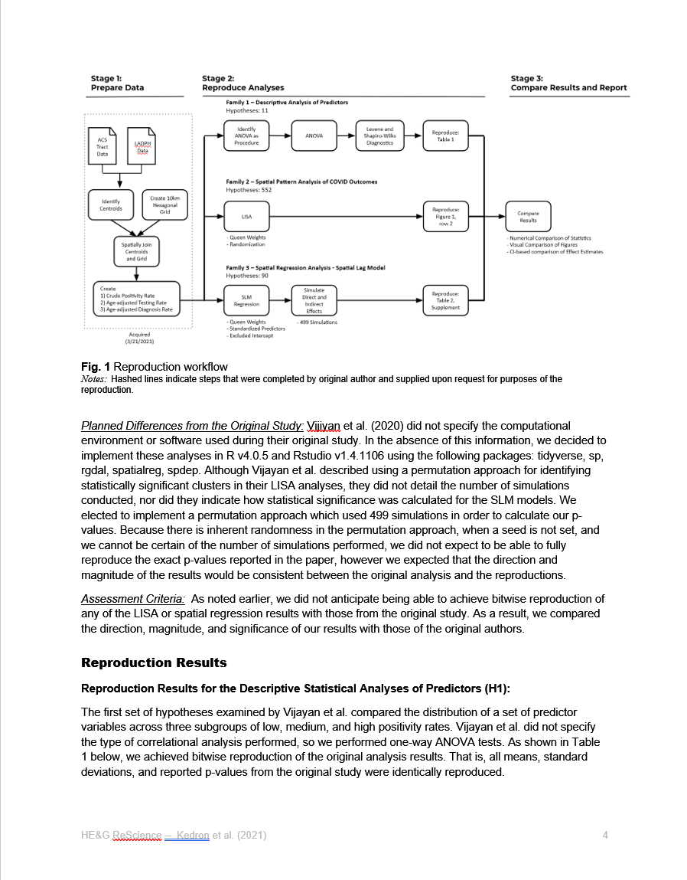
Some Typical Outputs
Open access data, methods, reports for research and teaching
Kedron
Expanding the Impact of Geographic Research
Kedron et al. (Revision), Geographical Analysis

Slide 33
HEGS-RR Infrastructure
A project-based demonstration of our infrastructure for reproducibility and replicability

Slide 34
Questions about Infrastructure?
We invite questions, feedback, and discussion about R&R in spatial data science

Slide 35
Open Discussion
We invite questions, feedback, and discussion about R&R in spatial data science

Slide 36
Discussion prompts
and invitation to collaborate…
Can you share any successes, advice, or best practices introducing reproducibility and replicability in your own scholarship (research or teaching)?
What barriers do you perceive to adopting open and reproducible research practices in your own scholarship?
Could any resources, changes, or incentives help overcome those barriers?

Slide 37
Thank You
Our R&R Related Resources
hegsrr.github.io
/Workshop-UCSB-2023
5 Peer-reviewed Publications
8 Reproduction and Replication Studies
2 Surveys of Researcher Practices
Reproducible Project Repository Template
Manual In Development
Course Syllabi
9 RAs Mentored
~50 Students Engaged in R&R Studies

